Slide 1
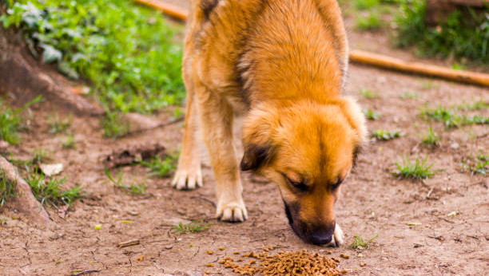

Frail Tails
Riya Verma, XII B

Slide 2
Acknowledgement
I would like to take this opportunity to express my deep sense of indebtedness to all those people without whom this project could not have been successful.
Firstly, I would like to express my heartfelt gratitude towards my parents for their constant love and support that encouraged me to keep achieving my goals.
I would also like to thank our Principal, Mrs. Sudha Acharya, for her patience and perseverance and for always being a pillar of support. I would like to express my sincere gratitude to my Computer Science mentor Mrs. Neelam Roy ma’am for their vital support, guidance and encouragement, without which this project would not have come forth.
2

Slide 3
Certificate
This is to certify that this Computer Science Investigatory Project, has been successfully
completed by Riya Verma (XII - B) of ITL Public School, under the guidance of Mrs. Neelam Roy, H.O.D. CS, in particular fulfillment of the curriculum of CBSE (Central Board of Secondary Education) during academic year 2022-2023.
Internal Examiner (signature)
External Examiner (signature)

Slide 4
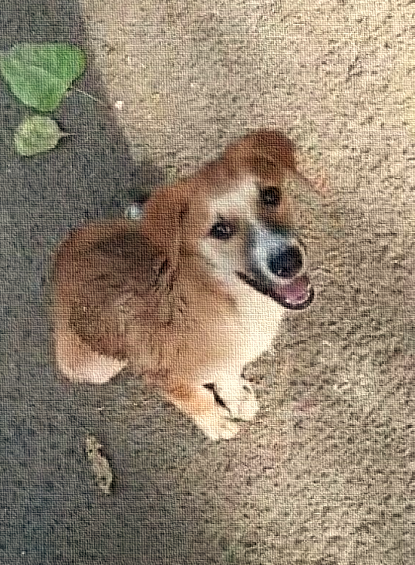
Index
Sno. | Topic | Page no.
1 | Introduction | 5
2 | Feasibility Assessment | 6
3 | Need of the project | 7
4 | Future scope | 8
5 | Detailed Design | 10
6 | Output | 17
7 | Python Code | 32
8 | Bibliography | 43

Slide 5
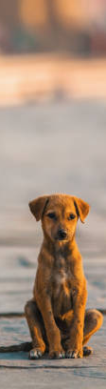
Introduction
Are you one of those dog lovers who wish to pet one but is not able to? Ever thought to shower this love, on that little innocent one that every day roams in front of your house with an expectation that you will help him/her out? If not, then you must give it a thought. If yes, then this project is something you would love.

Slide 6
Feasibility Assessment
35 M Stray dogs in India
High number of Dog Lovers
Court Cases – Restricting feed
5.7 Lacs Stray dogs in India (as per few year back count)
No Structured way to Feed Stray Dogs
Hungry dogs can be more offensive
Municipality, Delhi has identified, Sterilized Stray Dogs
No Places Identified to feed Dogs

Slide 7
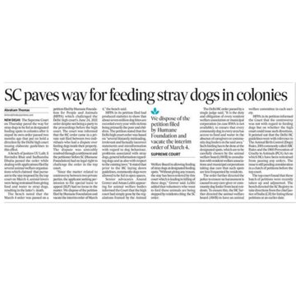
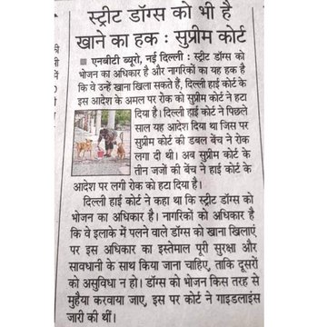
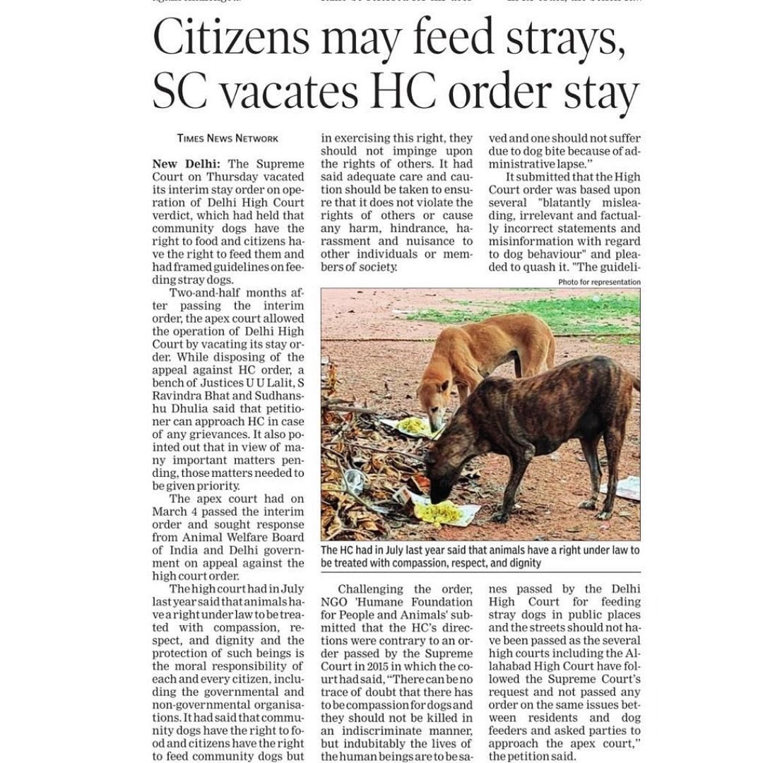
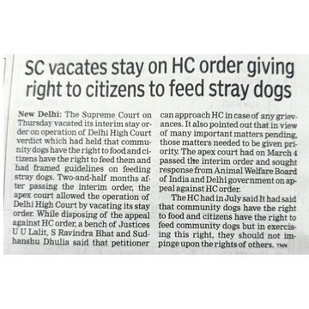

Need of the Project
Dogs, one of the most common living beings we see around us. India estimates to have around 60 – 65 million dogs comprising of both stray and pet. Out of this more than half, i.e., approximately 35 million are stray dogs.
Pet parents are always there for their dogs to fulfill all their needs. But these 35 million street dogs live without any shelter, scarce food and water. Due to this, every year we lose 10,000 of them. A bond between them and us is a wish from both sides, non-pet-parents and these little homeless creatures . When this topic reached to the supreme court, this what they had to say:
Keeping this in mind, this project aims to become an aid in this new order. It tries to create the Human-Canine-Bond.

Slide 8
Future Scope & Long Term Vision
To Create a Collaboration Platform for all Dog Lovers
To get Stray Dogs fed enough, to reduce Dog Bite Cases
To engage with government, municipalities to identify locations for feeding, and dog’s care

Slide 9
Future Scope - Phasing
Prototyping
Minimum Viable Product
Versions – Update & Upgrades
Demonstrating Purpose of Project by capturing Location & feeders data
View to feeder for unserved locations
Working system with all inputs outputs
Geofencing of area and search through google maps etc
Real time updates
Registered feeders and unregistered feeders (by site survey)
Daily update of food, water & milk served/ not served at site
Alarms and message to feeders
More detailed functionality
Mobile app and Portal (for laptop users)
Regular software Update & Upgrades
On multiple clouds
Advertisements of Pet Consumable and doctors for income

Slide 10
Detailed Design
10

Slide 11
Processes & Service
Location & Stray Data Upload
Area Updates
Municipality Data
Application Database
Registration
Area View
Update Support Provided
Donate Funds
Offer Vet Help
Prototype
Roadmap

Slide 12

FRAIL TAILS
Welcome Dog Lovers
TO THE WORLD OF STREET DOGS
+91 <MOBILE NUMBER>
I agree to the Terms and Conditions and Privacy Policy
Click to proceed
Skip to proceed

Slide 13
FRAIL TAILS
Member Registration
Your registered mobile number
Your Pin code
Create Password **
Re-enter password **
Email Id
Are you a veterinary doctor
Can you provide funds for this initiative
Can you invest time in updating about street dogs on daily basis
Any suggestions to improve this initiative
Upload photo of dogs in your area**
< >
< >
< >
< >
< .com>
<Y/N>
<Y/N>
<Y/N>
<Open Box for remarks (500 char)>
<Upload (Max size 1MB)>
** Currently not in prototype, but as a feature its shall be captured in future

Slide 14
FRAIL TAILS
Stray Location Master
Location Name*
Pin code*
Landmark (colony name, School or any other) *
No of Stray Dogs on Street *
Is Municipality defined Area for Feeding *
Exact location of Feeding Point (Google Map**) *
Number of Food Pots
Number of Water Pots
Number of Milk Pots
Remarks
< >
< >
< >
< >
<Y/N>
< >
<##>
<##>
<##>
< >
* The first Six field shall be pulled from Municipality data in future (Roadmap)
** Currently not in prototype, but as a feature its shall be captured in future

Slide 15
FRAIL TAILS
Search/ View for Feeder
Your area <Pin code> Vision : To have zero stray dogs unattended Strategy : Use digital platform Frail Tails to bring all helping hand together | WHERE WE ARE TODAY
Dogs on street : <no. of dogs registered>
Helping Hands: <no. of people registered>
Food Pots : < >
Water Pots : < >
Milk Pots : < >
No. of Doctors : <no. of Doctors registered>

Slide 16
Database Design
Registered_Users
Location_master
Field | Type | Length
Mobile Number | Numeric | 10
Name | Alpha | 30
Email-Id | Alphanumeric | Var
IsFeeder | Alpha | 1
IsVetDoc | Alpha | 1
IsFundDoner | Alpha | 1
IsVetCarer | Alpha | 1
Suggestion | Alphanumeric | Var
Field | Type | Length
PIN Code | Numeric | 6
Area Name | AlphaNumeric | 20
Feeding_point | Alpha | 1
Lat Long | AlphaNumeric | 20
Feeder_count | Numeric | 2
Food_Pots | Numeric | 2
Water_Pots | Numeric | 2
Milk Pots | Numeric | 2

Slide 17
Output of Executed code
17

Slide 18
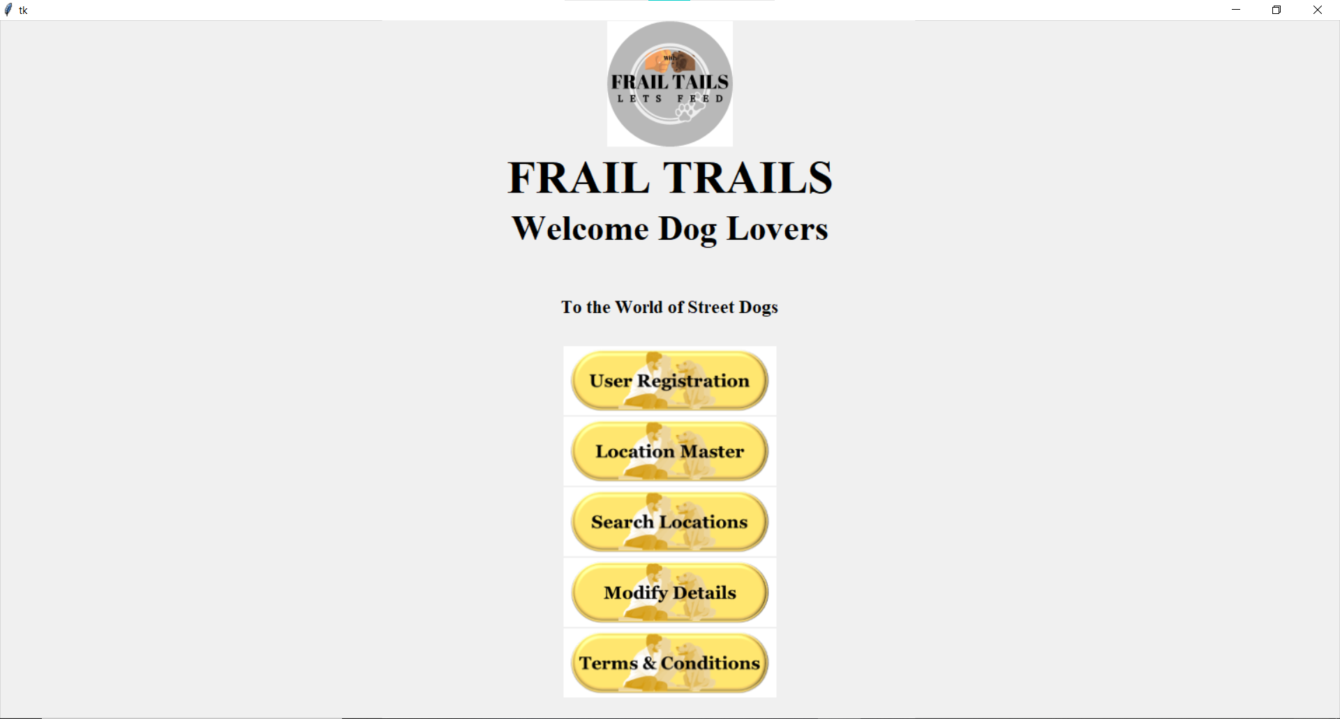

Slide 19
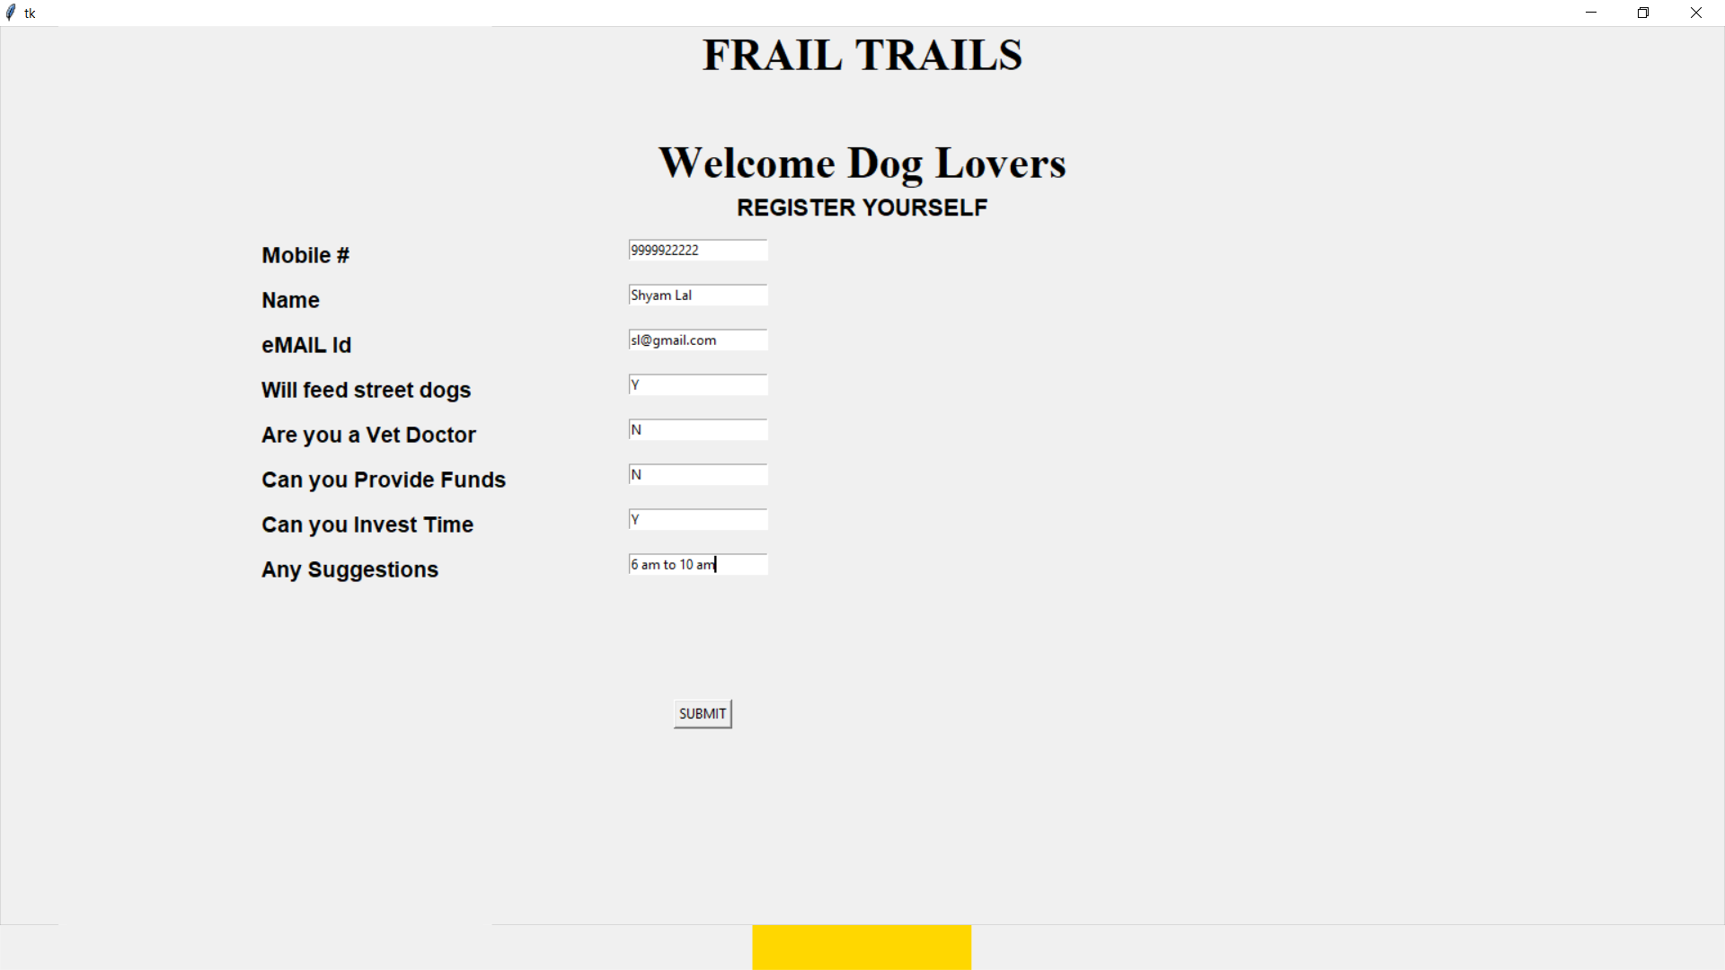

Slide 20
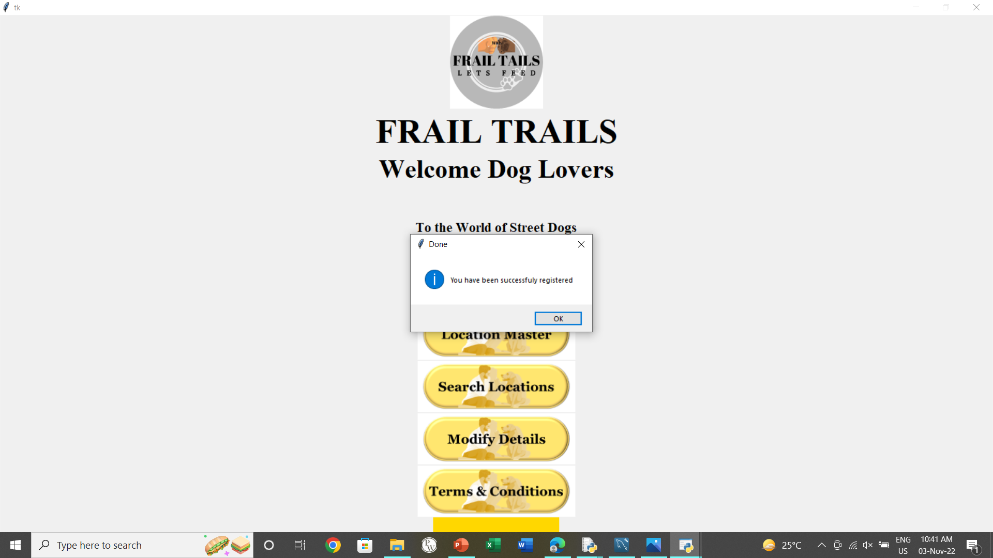

Slide 21
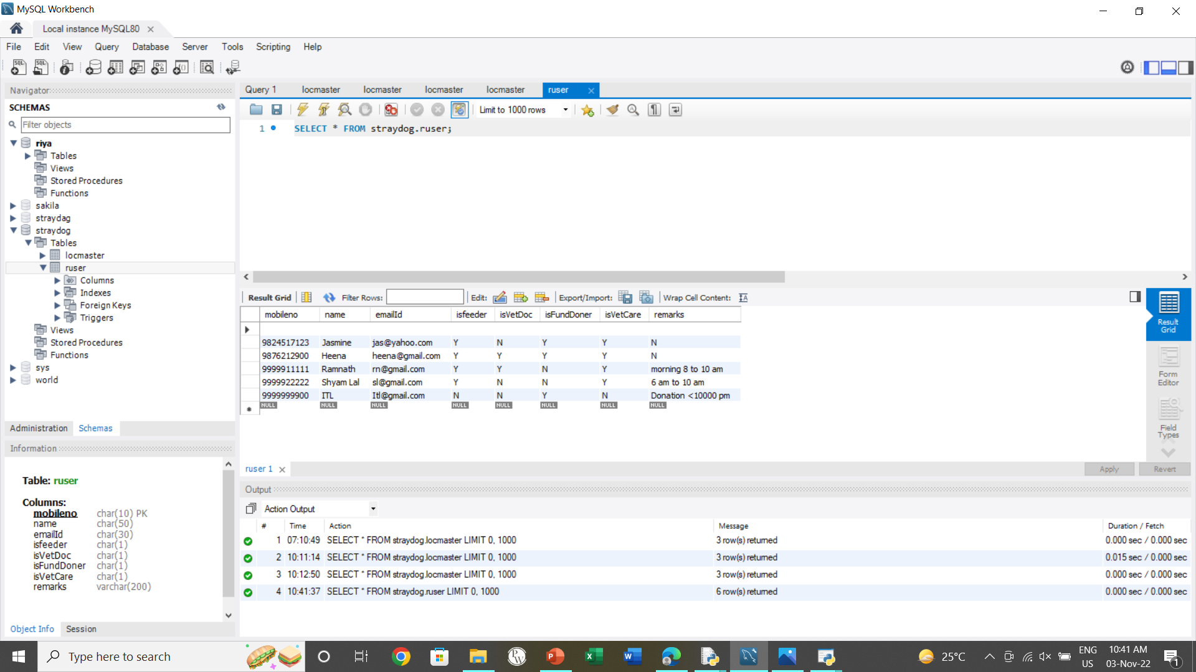

Slide 22
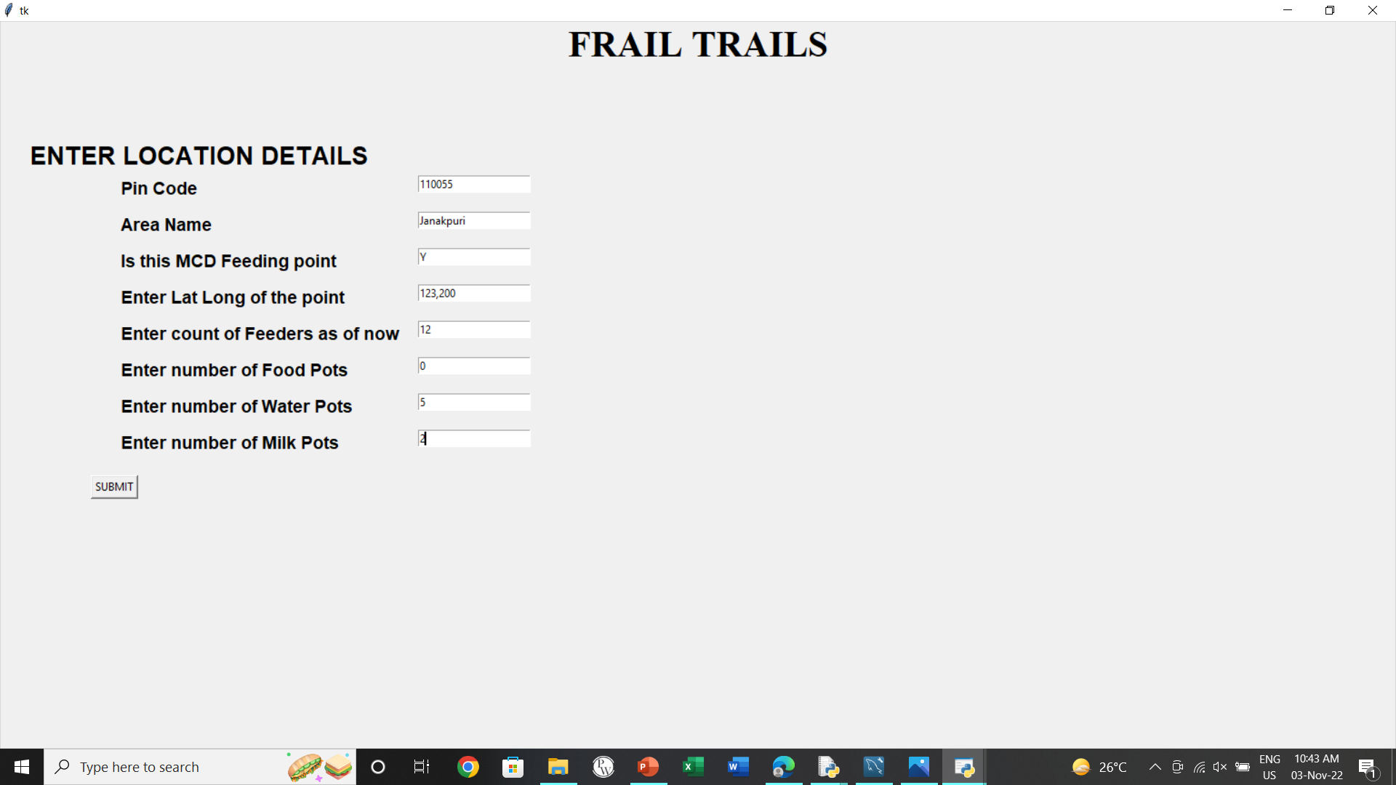

Slide 23


Slide 24
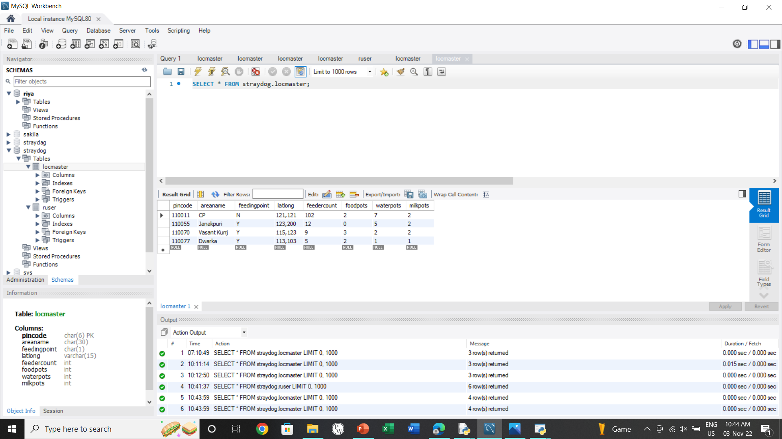

Slide 25
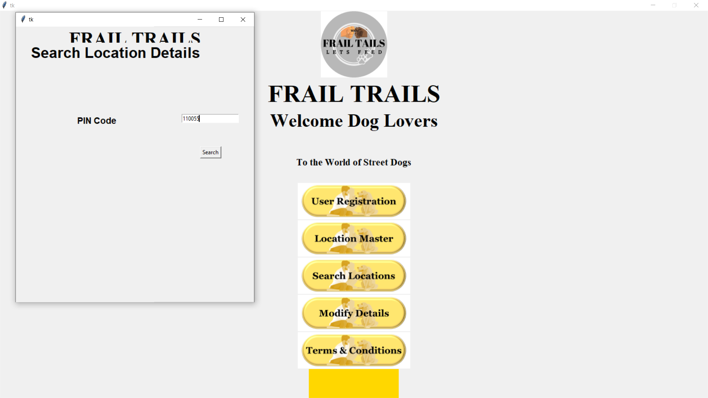

Slide 26
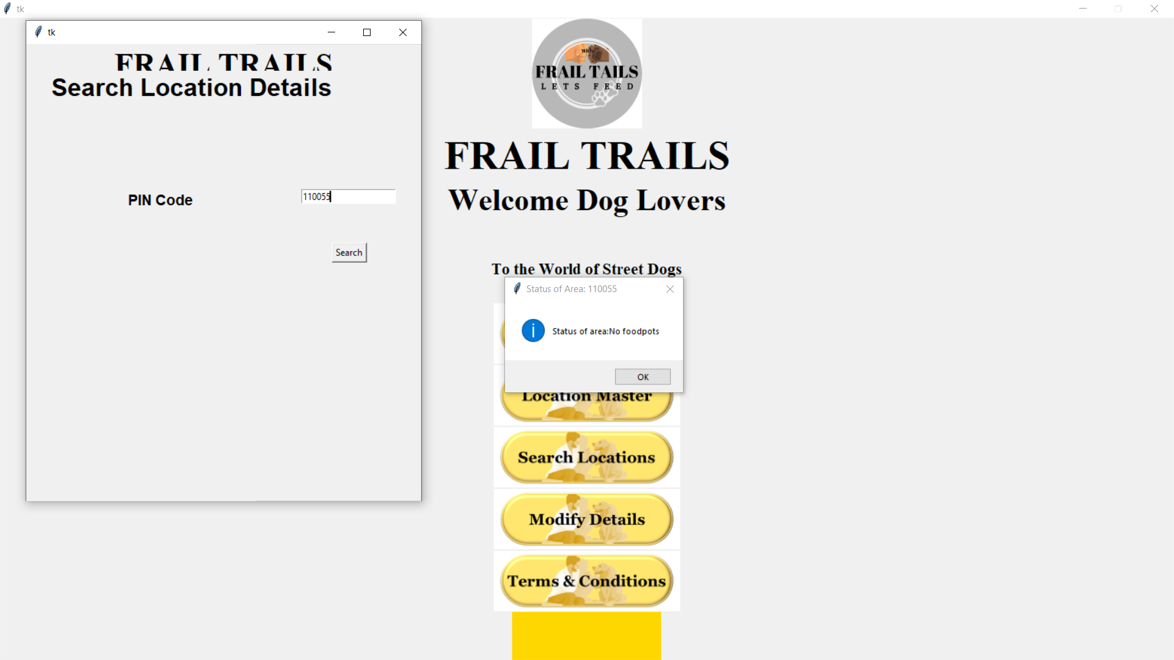

Slide 27
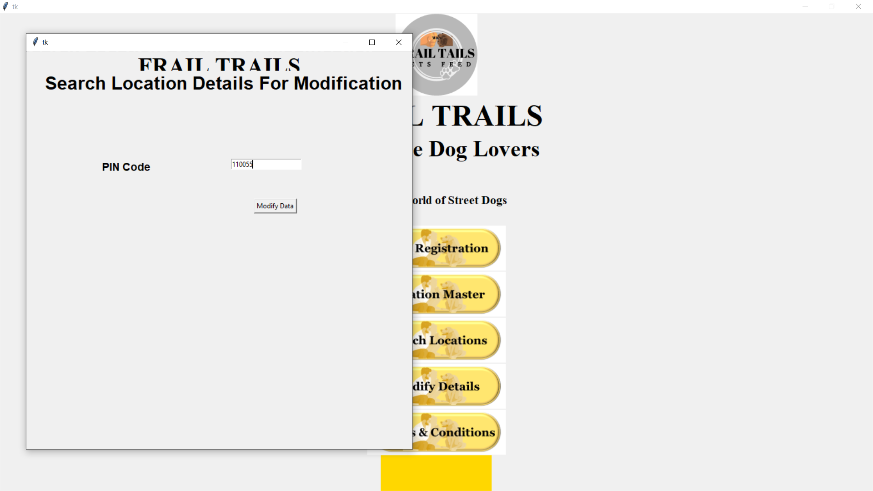

Slide 28
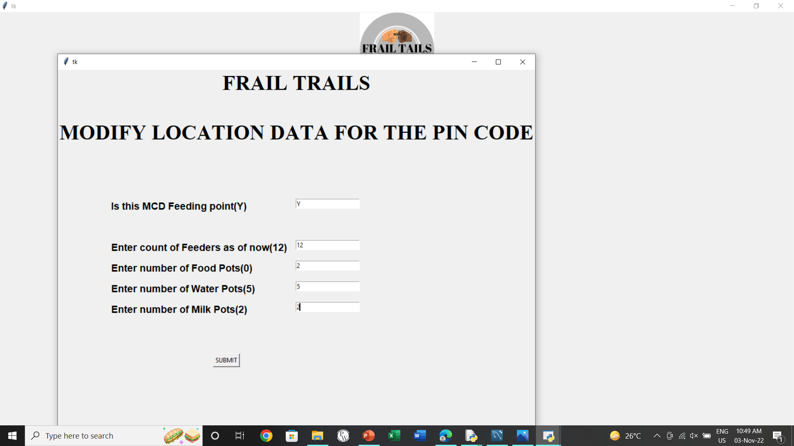

Slide 29
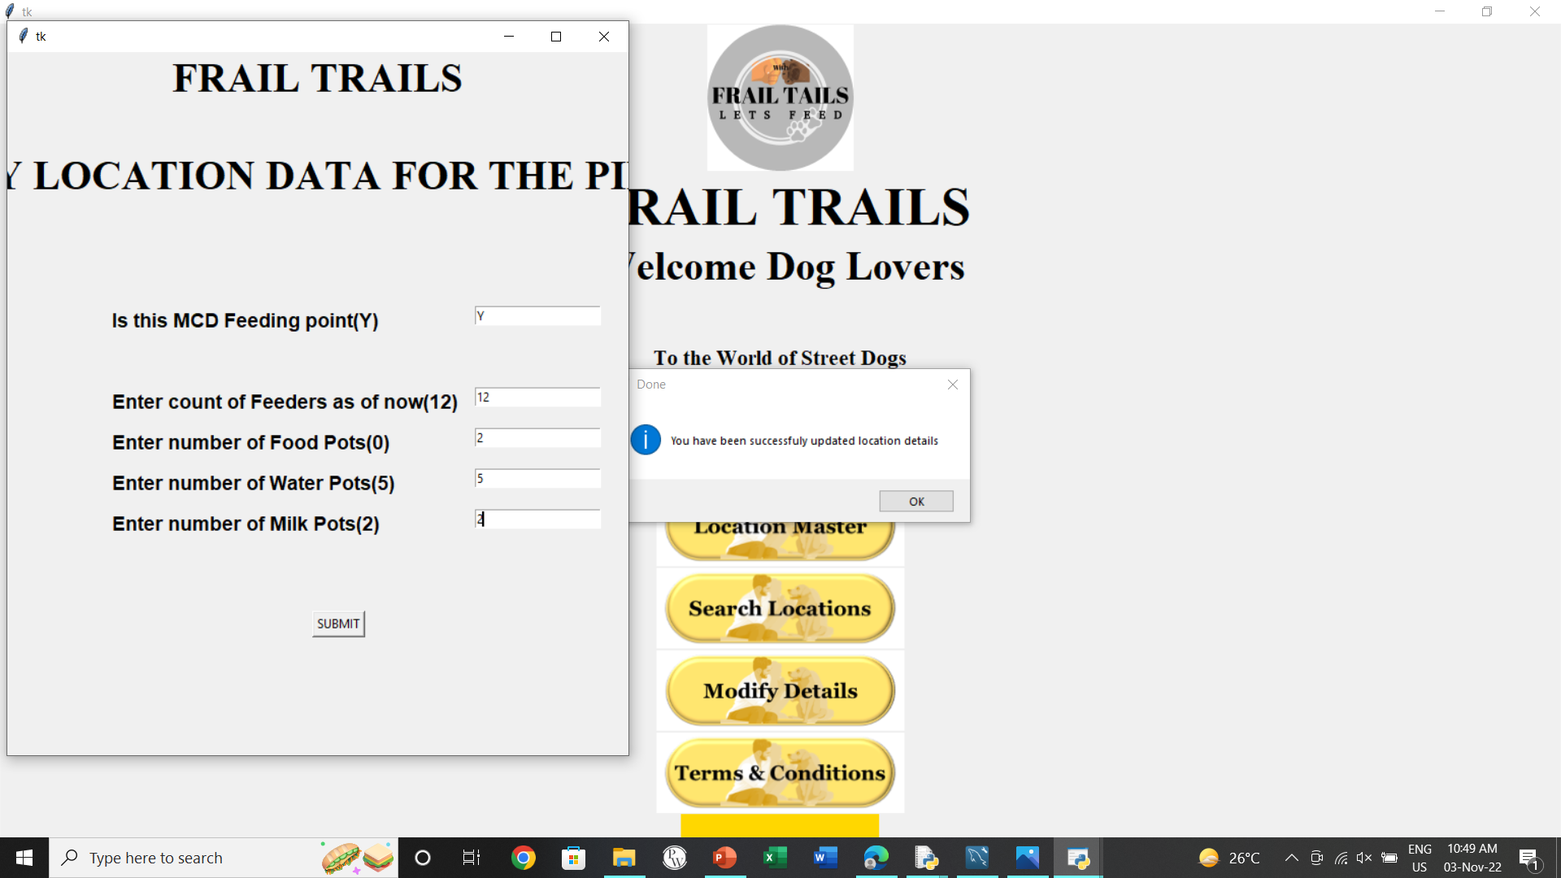

Slide 30
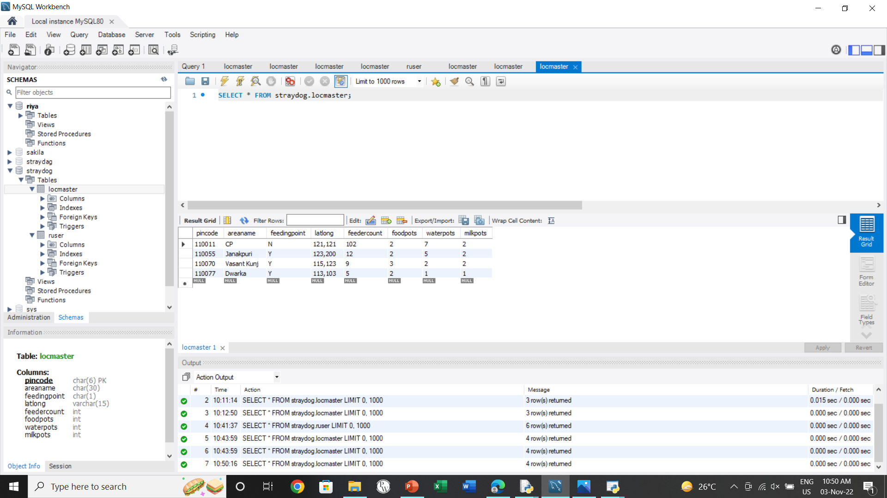

Slide 31
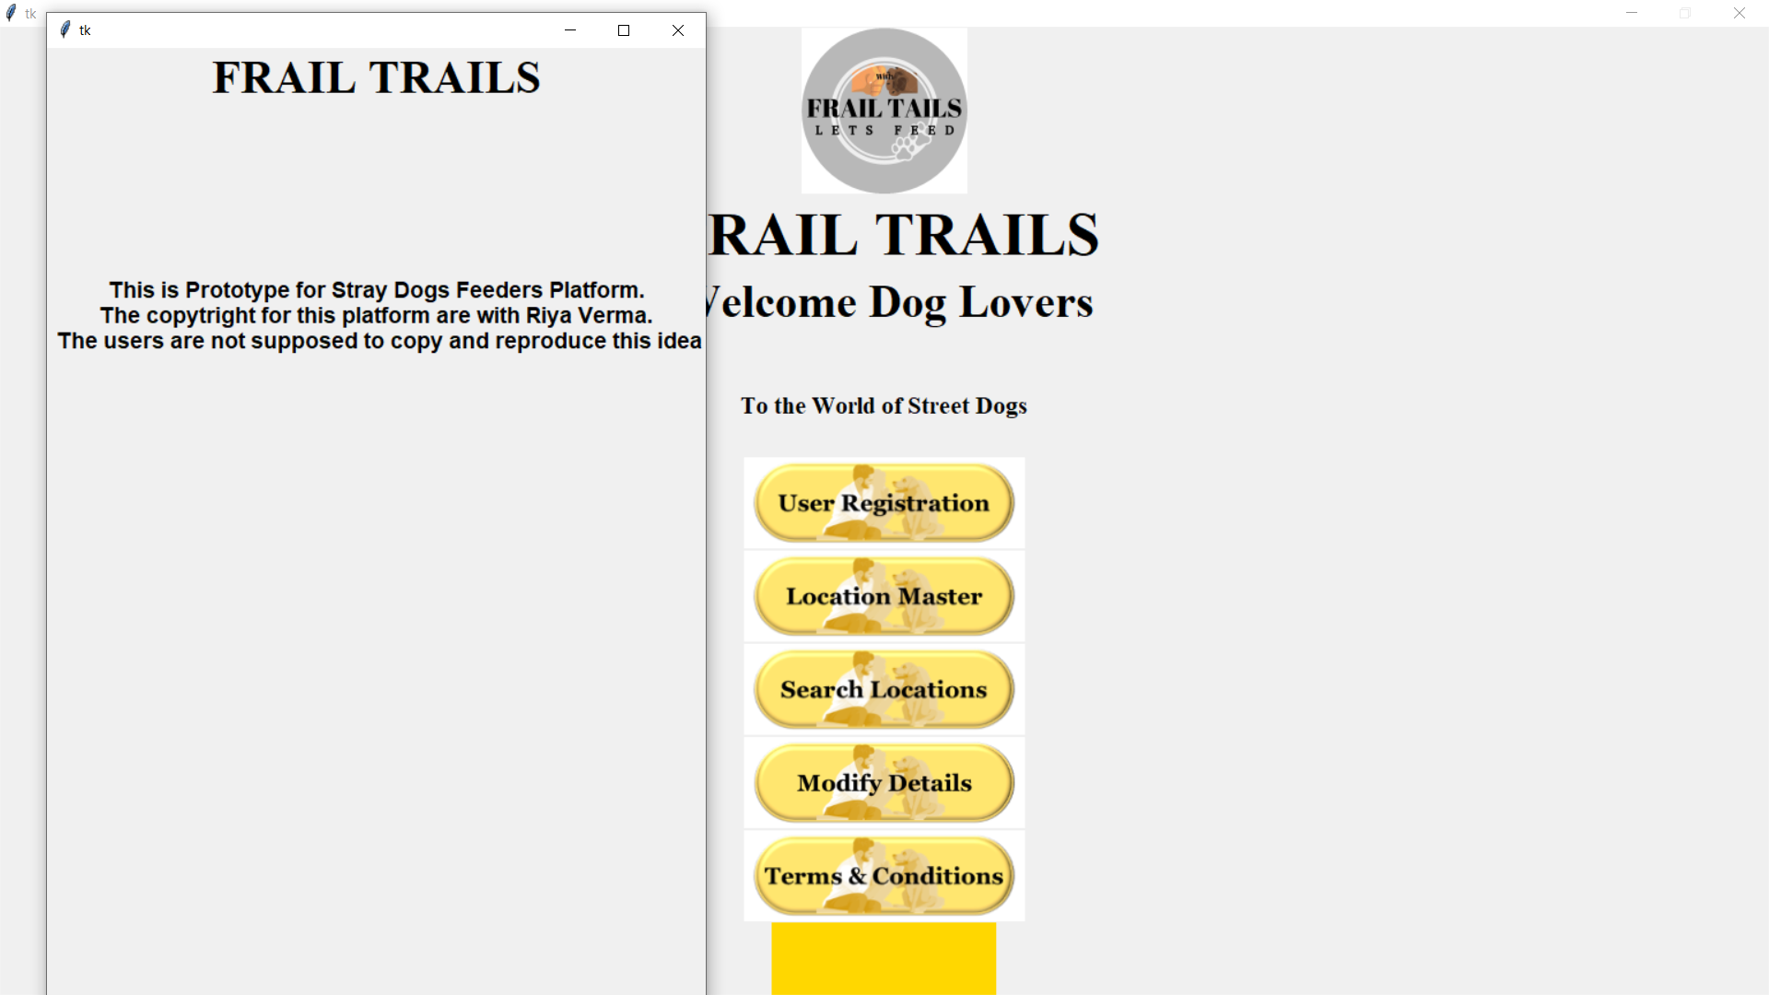

Slide 32
Python Code
Frail Tails Prototype

Slide 33
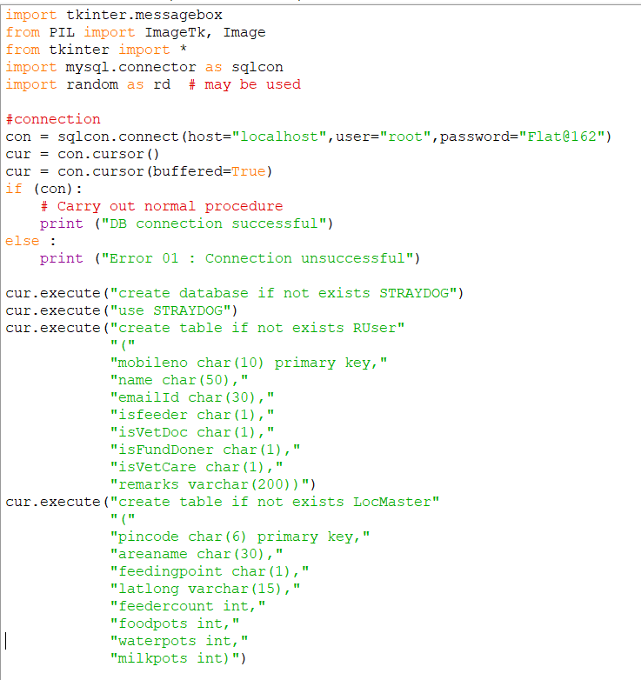
Connecting with Database & DB Structure Creation

Slide 34
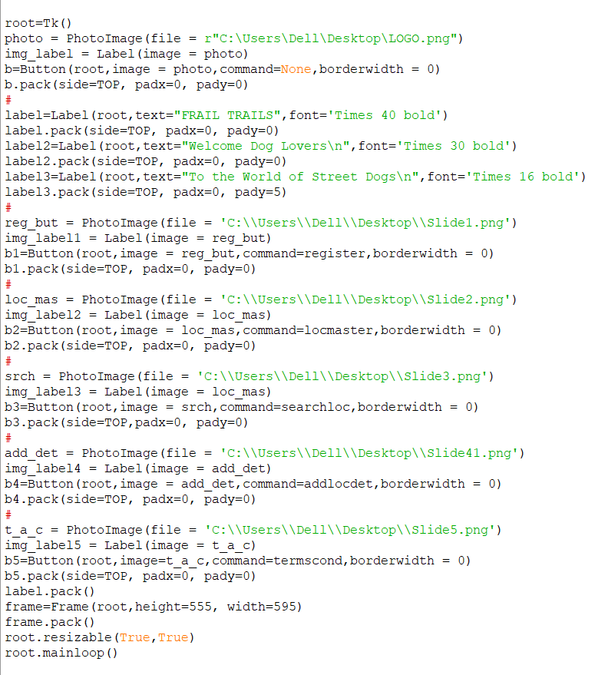





Main Menu
Images Used

Slide 35
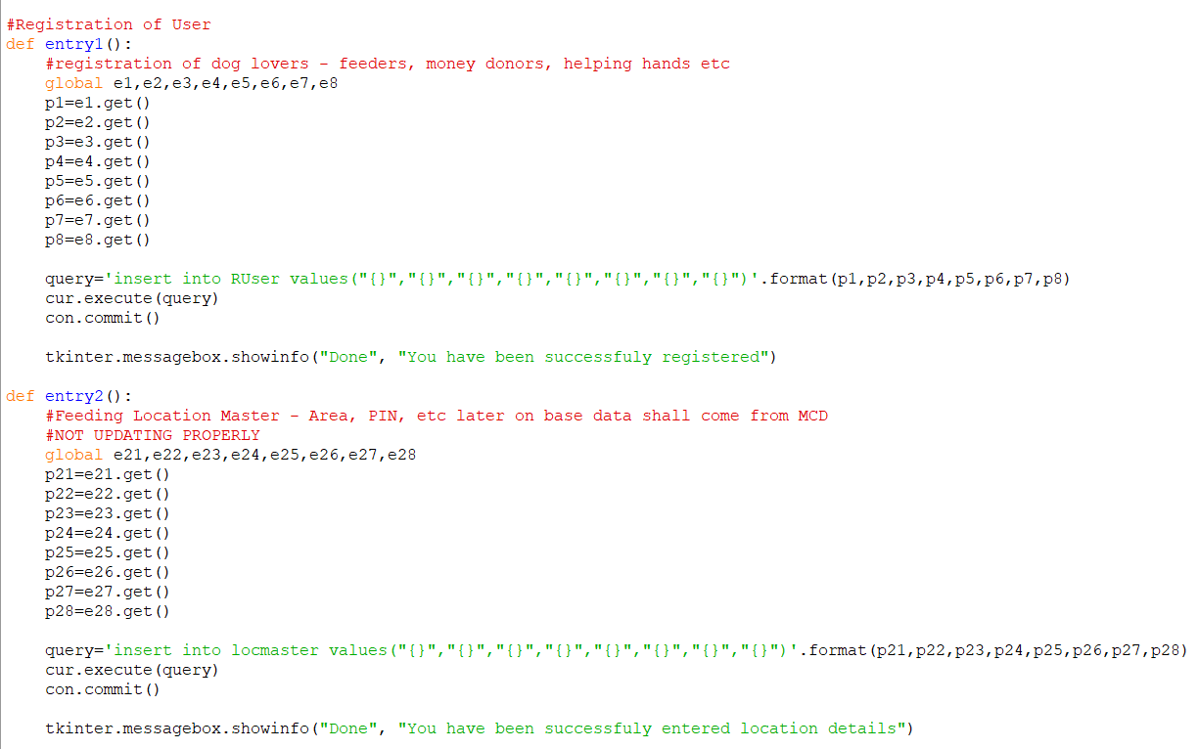
Inserting Records in Database

Slide 36
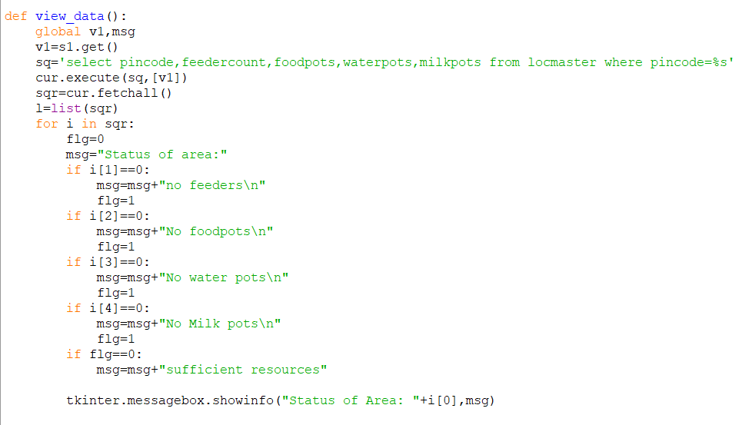
Searching Records in Database

Slide 37
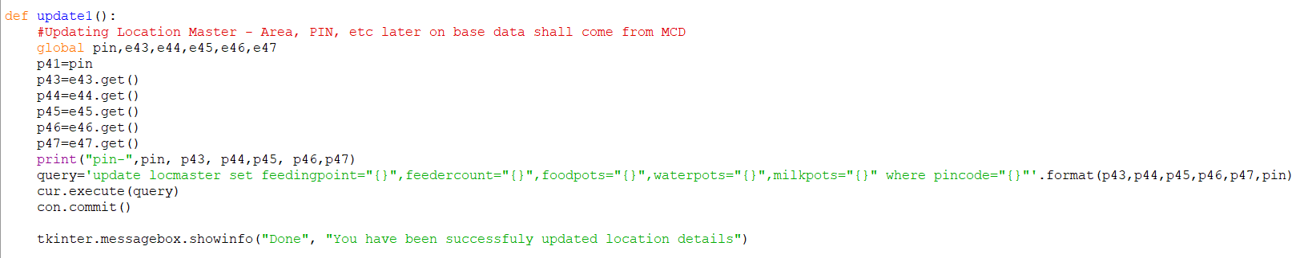
Updating Records in Database

Slide 38
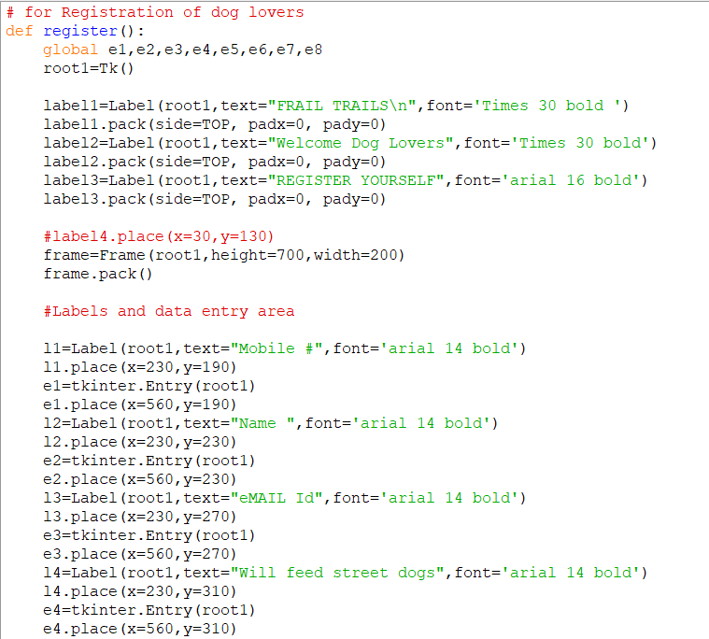
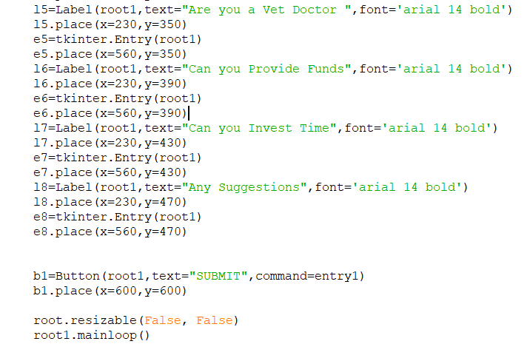
User Interface for Registration of Dog Lovers

Slide 39
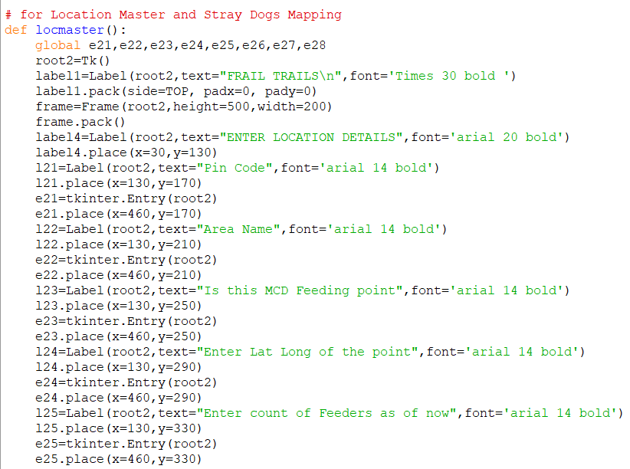
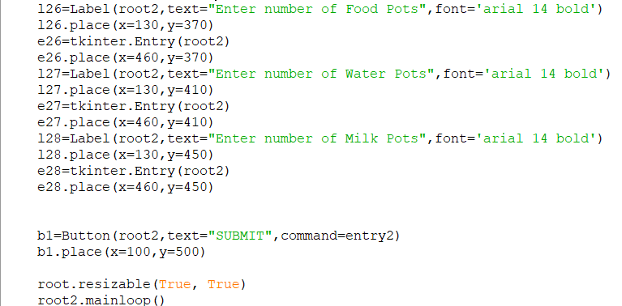
User Interface for Location Details

Slide 40
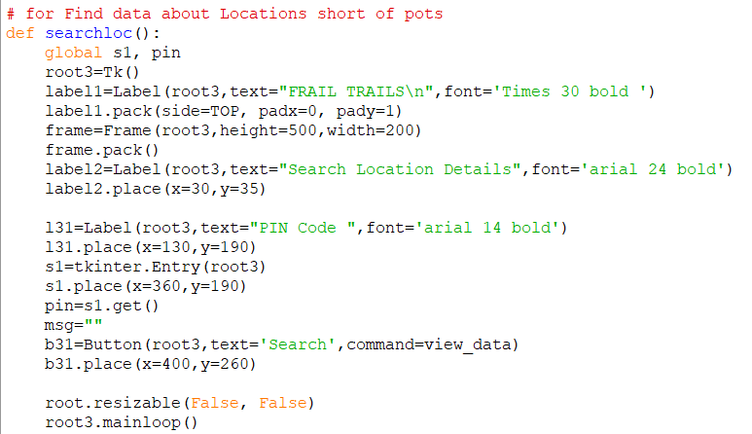
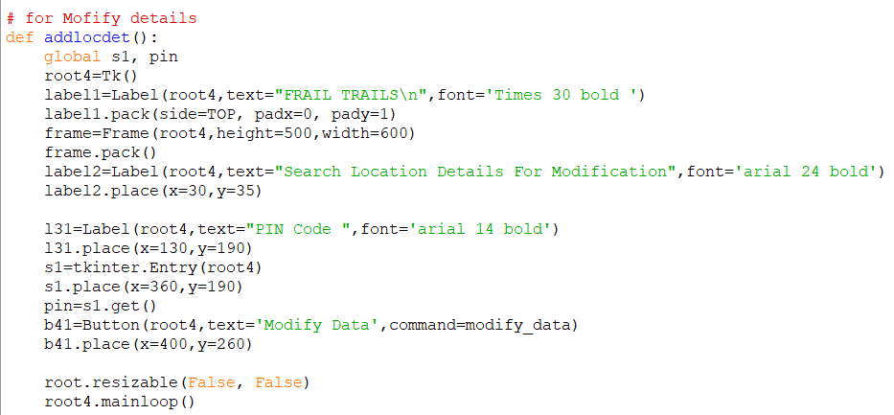
Searching Location Details
Procedure for evoking Modification entry

Slide 41
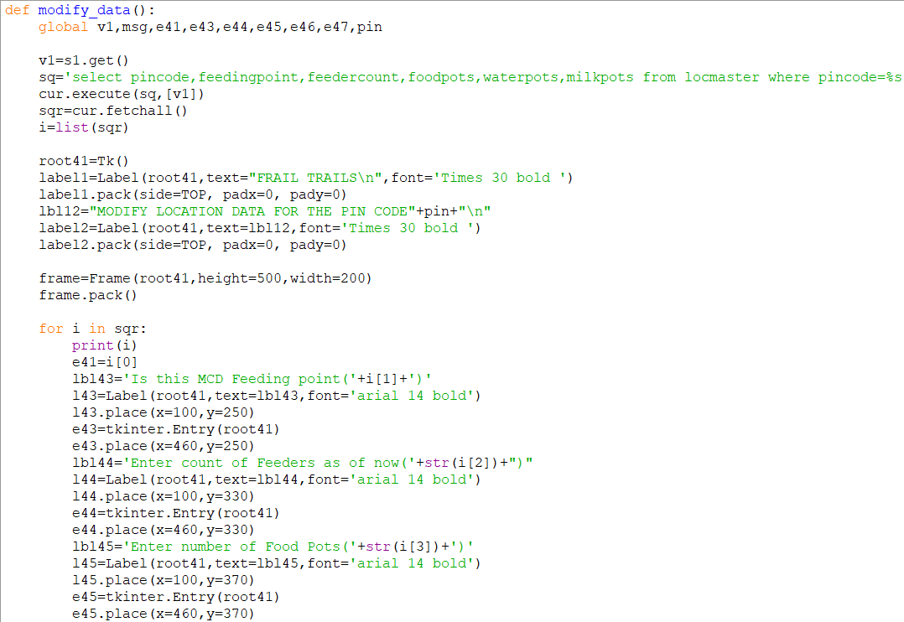
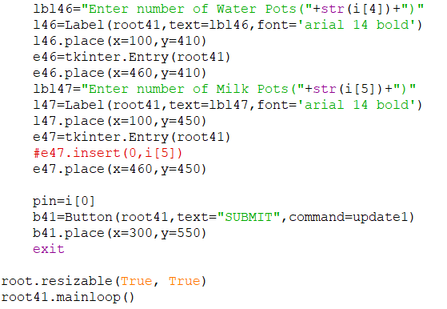
Modification User Interface with old data populated

Slide 42
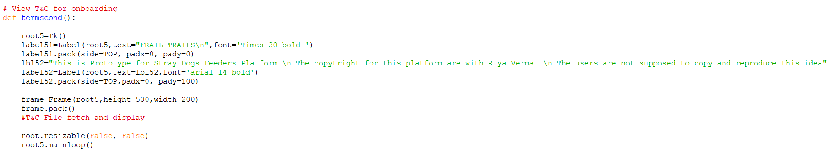
Terms & Conditions

Slide 43
Bibliography
Website search for Project data
https://www.livemint.com/industry/retail/spike-in-ownership-boosts-pet-care-retail-biz-11632076482359.html#:~:text=and%20anxiety%20issues.-,India%20has%20an%20estimated%20pet%20population%20of%2028%E2%80%9329%20million,the%20bulk%20of%20pet%20ownership.
https://timesofindia.indiatimes.com/life-style/relationships/pets/6-facts-about-stray-dogs-in-india/photostory/89346302.cms#:~:text=In%20India%2C%20there%20are%20more,can%20care%20for%20these%20dogs.
https://twitter.com/pfaindia/status/1527560337729343488/photo/1
Books & Reference Material
Sumita Arora : Computer Science with python
Tkinter 8.5 reference: a GUI for Python (tkdocs.com)

